Slide 1
SharePoint Development in the Enterprise (What's New, What's Coming)
BRK2250
Daniel Kogan
Group Prog. Mngr.
SharePoint Developer Platform

Slide 2
Let’s talk about…
SharePoint in the Enterprise
What we’ve done since the last time we talked
What’s new
What’s coming soon

Slide 3
Goals
Understand the SharePoint Developer model
Learn what is available today
Discover the possibilities
Get you as excited as we are

Slide 4
SharePoint in the Enterprise

Slide 5
The trusted cloud available everywhere
Microsoft Cloud
Office 365
Over 90% of the Fortune 500
100 million monthly active users
Trusted and compliant
Office 365 Trust Center
Regional, secured data centers
eDiscovery and legal hold

Slide 6
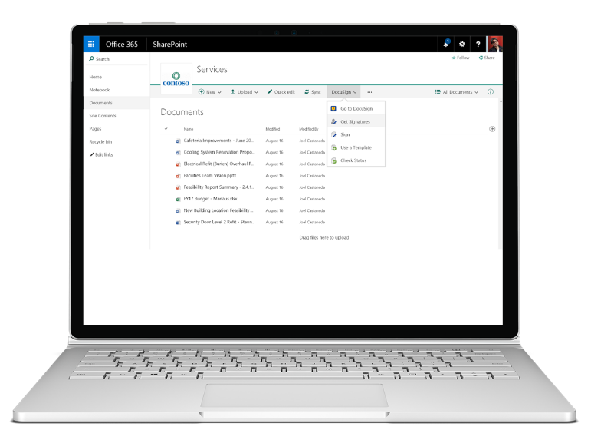
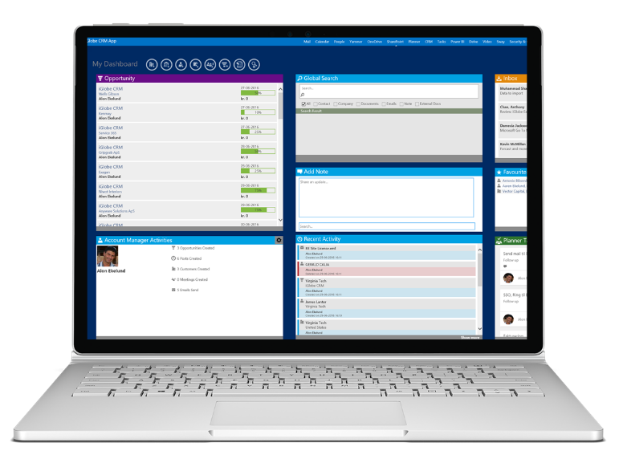
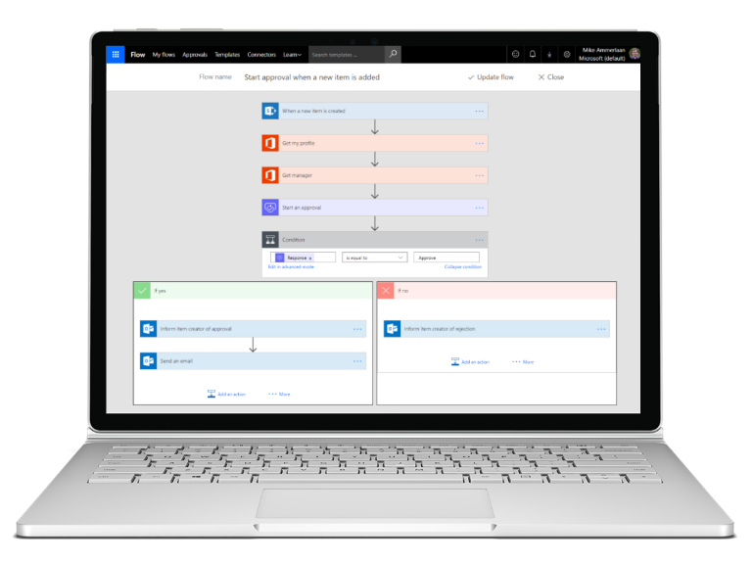
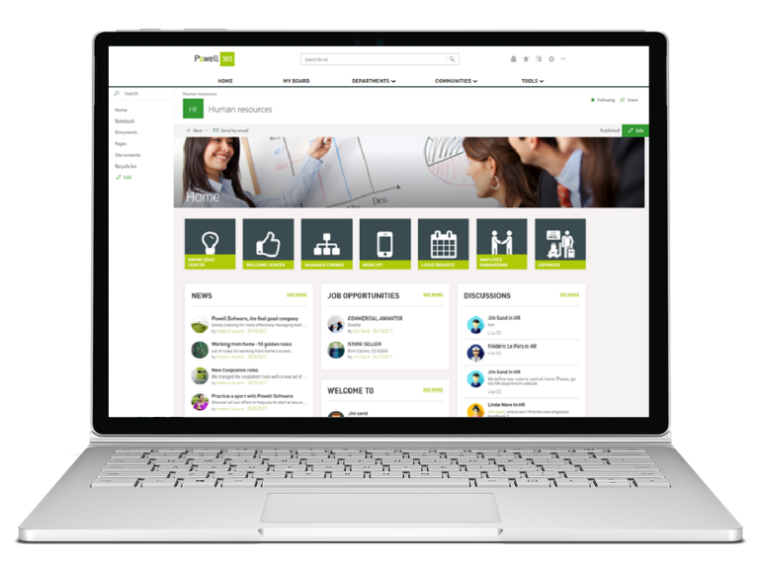
Built with SharePoint
Site experiences Extend team and communication sites
Integrations Bring tools and applications together in one place
Processes and workflows Manage and build rules around content
Business applications Boost team productivity with custom apps
business application

Slide 7
SharePoint as an Enterprise Development Platform
User experience
Data and APIs
Processes
Packaging, deployment, and store
SharePoint Framework (SPFx)
PowerApps
Add-in parts & custom actions
Graph APIs
Client Object Model (CSOM+JSOM)
REST
Files API
Webhooks
Microsoft Flow
Workflows
Remote event receivers
SPFx client side solutions
Add-ins and SharePoint Store
Declarative solutions

Slide 8




SPFx Development in SharePoint
SharePoint [empowers you to]
Share and work together
Inform and engage people
Transform business process
Harness collective knowledge
Protect and manage
Extend and develop
SharePoint Framework [enables]
Modern client-side development
Lightweight web and mobile
Industry leading client side solutions On-Premises and in the Cloud
An Application Development Framework that aligns 1st and 3rd parties
Backward compatible components
Open source tools and JavaScript web frameworks in SharePoint pages

Slide 9
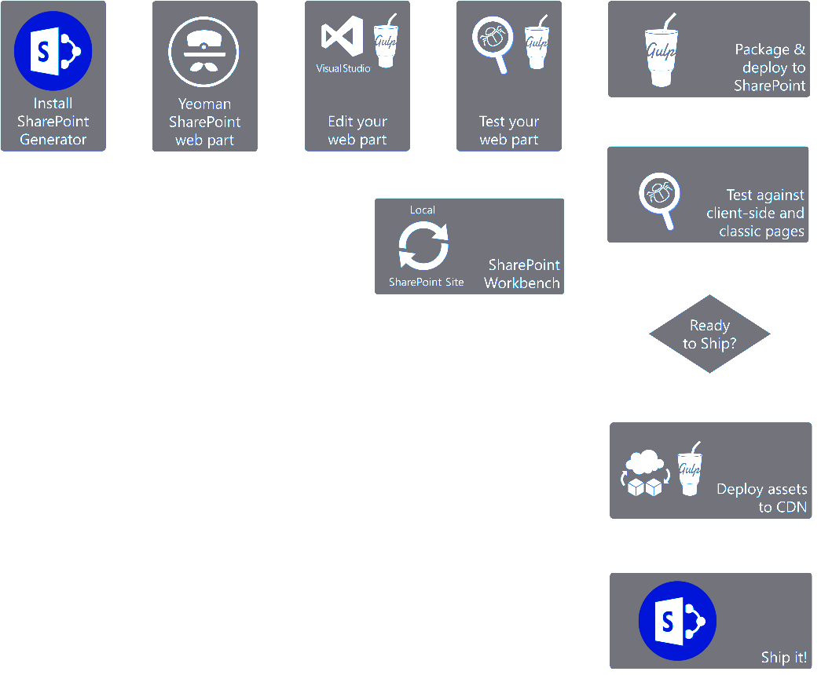
Let’s talk about the Tech
Client side technology
Responsive by design
Open source toolchain
Platform agnostic
JavaScript (TypeScript)
Based on the latest industry standards

Slide 10
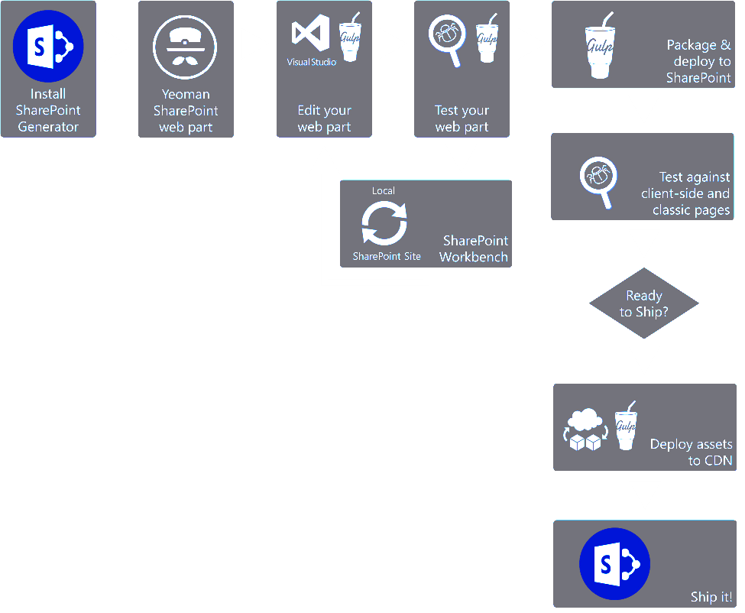
Let’s talk about the Tech
Client side technology
Responsive by design
Open source toolchain
Platform agnostic
JavaScript (TypeScript)
Based on the latest industry standards

Slide 11
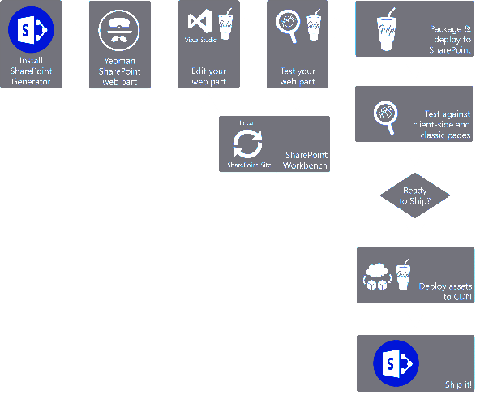
Let’s talk about the Tech
Client side technology
Responsive by design
Open source toolchain
Platform agnostic
JavaScript (TypeScript)
Based on the latest industry standards

Slide 12







Server side tool comparison
SharePoint Server Side
IIS Express
C#
MSBuild
Project Templates
SharePoint Client Side
Microsoft Confidential

Slide 13
A busy year

Slide 14
SPFx rapid release cadence
Sept 1, 2016
SPFx Drop 2
Sept 21, 2016
SPFx Drop 4
Nov 22, 2016
SPFx Drop 6
Feb 23, 2017
SPFx GA
Aug 29, 2017
SPFx Extensions RC0
Aug 9, 2017
Tenant Admin Deployment
Aug 17, 2016
SPFx Drop 1
Sept 14, 2016
SPFx Drop 3
Oct 17, 2016
SPFx Drop 5
Jan 9, 2017
SPFx RC0
June 12, 2017
SPFx Extensions Preview
Sept 12, 2017
FP2 for SP2016 (SPFx for on-prem)
Client side web parts
Modern tool box integration
Responsive by design
CDN Support
Front end development tool chain
Compatibility with classic pages
Workbench
Property panel
APIs
Samples
Documentation
Package deployment and app catalog integration
Shipped since last Ignite!!!

Slide 15
Out of the box

Slide 16
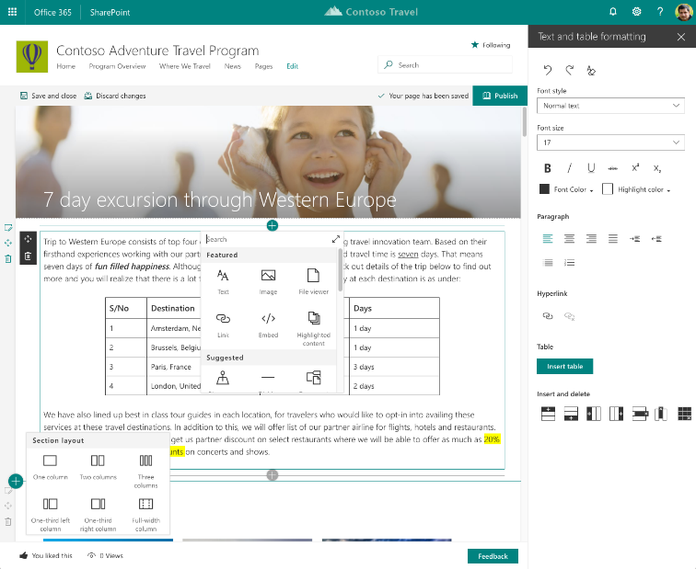
Easily create powerful, beautiful looking pages
Authoring
WYSIWYG authoring
Multi-column sections
Drag/ drop editing
RTE & Paste support
OOB web parts
Page Templates

Slide 17
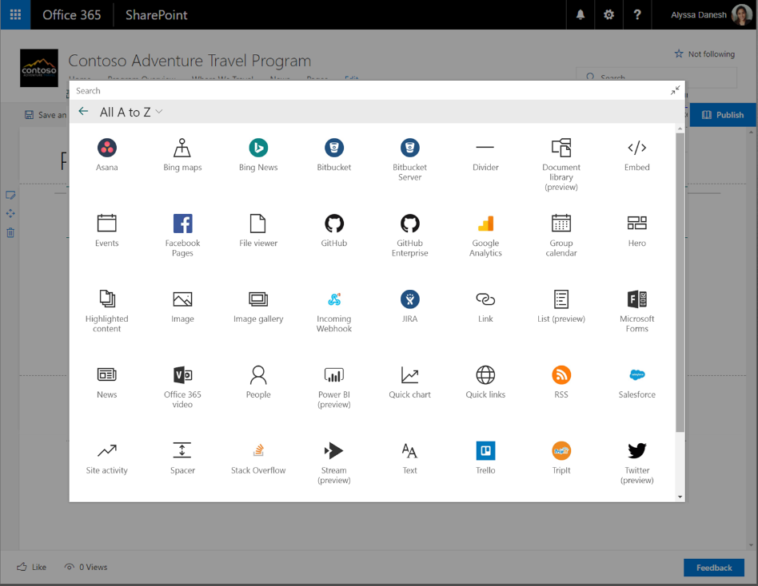
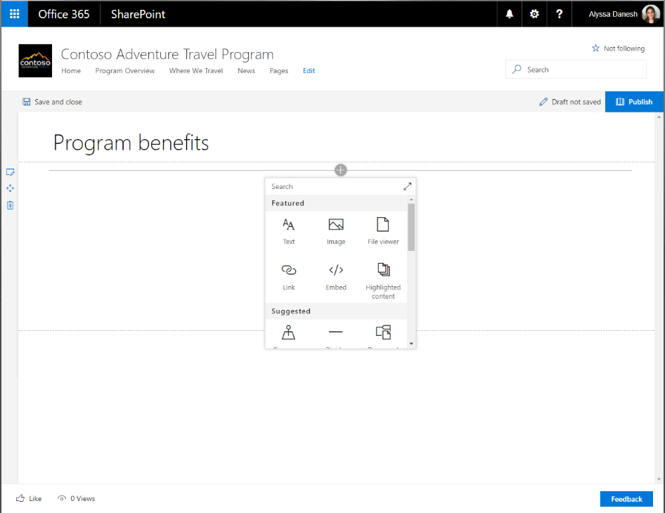
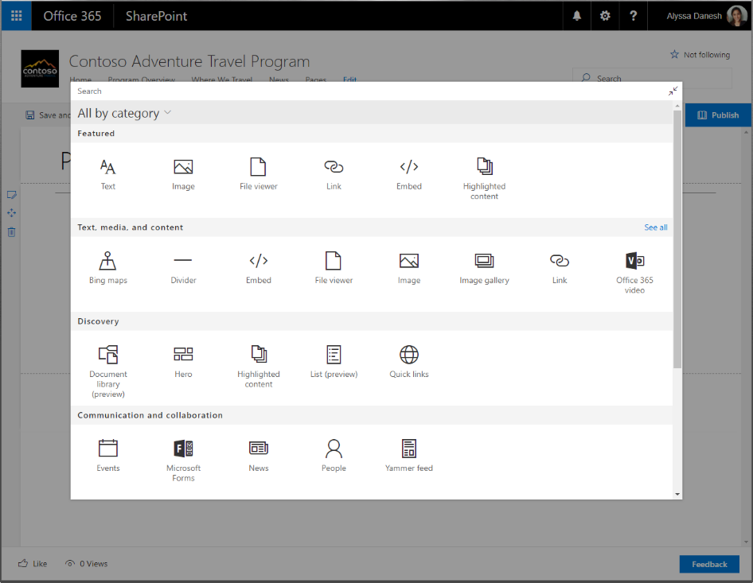
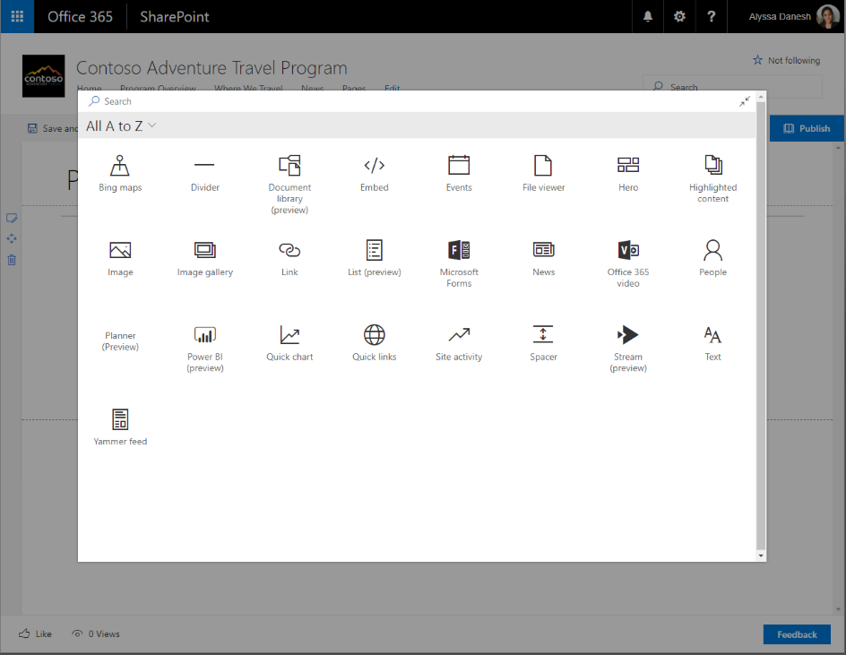
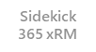
Web Parts and Toolbox
Large Tool Box
Search
Sort by Group or Alpha
Includes Connectors
Includes SharePoint Add-ins

Slide 18
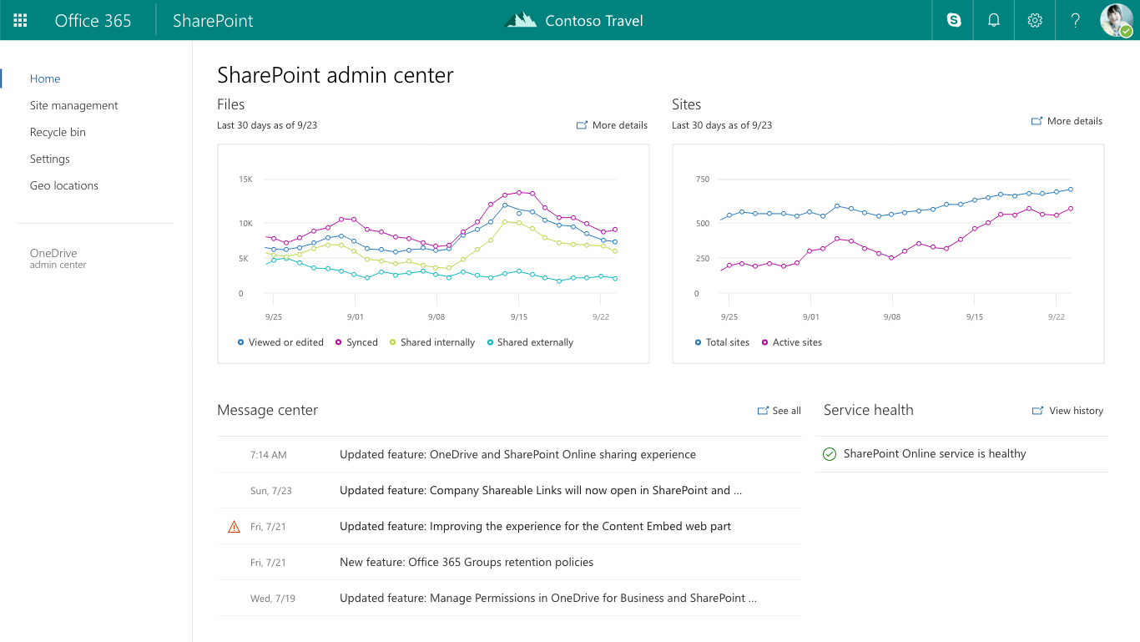
Admin Center
Great new experience for managing modern site types. (Groups, Comm. Sites)
Updated look and feel to match the rest of the SharePoint experience
Build on Modern Tech SPFx + Fabric React

Slide 19
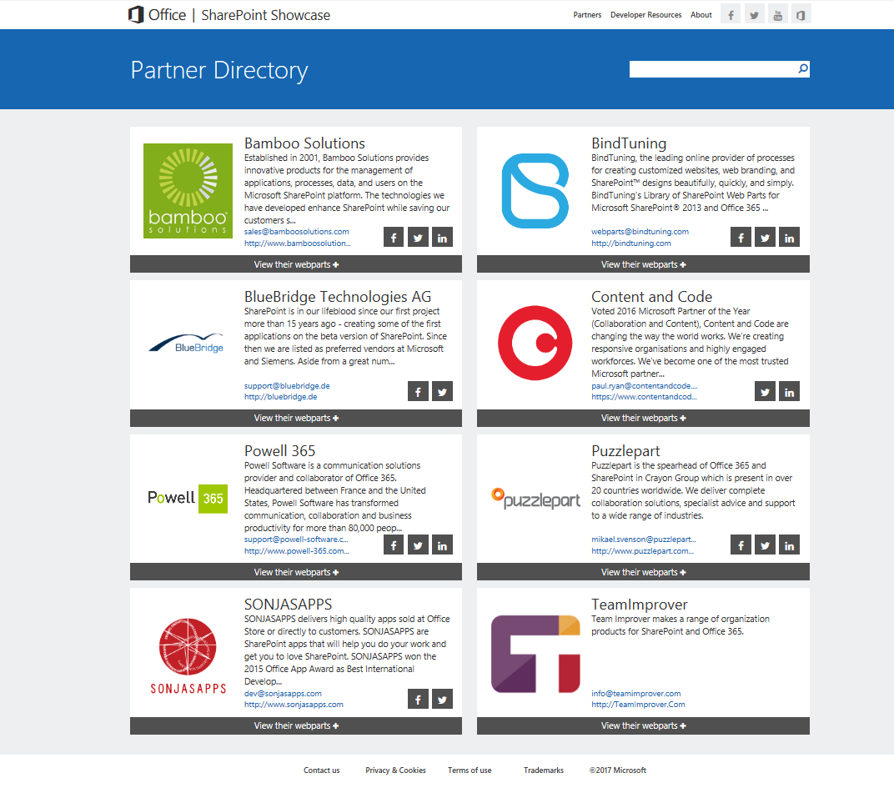
Partners building with #SPFx
Check it out: https://sharepointshowcase.office.com

Slide 20
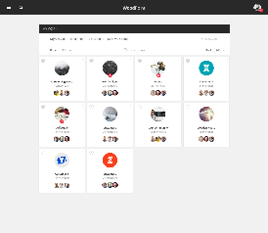
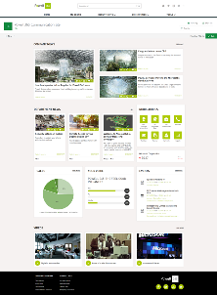



Momentum – Partners building with #SPFx
Valo Intranet Teamwork 2.0
Powell Communication & Team Sites
www.valointranet.com
www.powell-365.com
www.voitanos.io
Mastering SPFx Online courses

Slide 21

Things we’ve been asked…
“It’s a public CDN?”
“Github? Open source in the enterprise?”
“TypeScript, really?”
“Frameworks? Which one?”
Deployment/ Acquisition (Store)

Slide 22

We listened and reacted to your feedback
“My SharePoint is On-premises for the foreseeable future”
“We need custom code to meet our business needs”
“Be flexible, but don’t break my code”
“You asked me to learn a bunch of new stuff – make it worth our time”

Slide 23
Announcements –

Slide 24

Feature Pack 2
SharePoint Framework client side web parts on classic pages for SharePoint Server 2016
Use modern tools, platforms, and open source
Common development platform across on-premises and the Cloud
Getting head-start on your cloud migration
Targeting SharePoint Framework ~1.1 support
Released

Slide 25
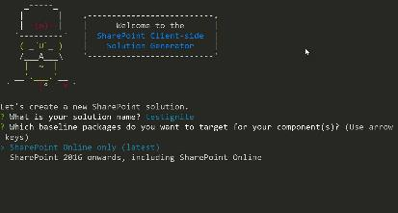
Yeoman Generator 1.3
Convergence of on-premises and cloud tool chains
The new Generator will now build different packages
depending on whether you are building for the
cloud or On-premises.
Cloud option is cloud only,
On-premises will allow the On-prem package to run in both
environments.
GA Today!!

Slide 26
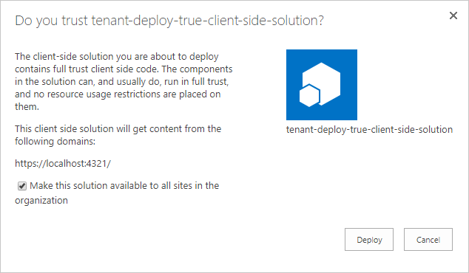
Tenant wide deployment
Create and Deploy SPFx components (web parts and extensions) that are immediately available to all site collections
Released
Restrictions apply
Tenant-wide solutions don’t include Feature provisioning

Slide 27
Demo: Let’s deploy!!

Slide 28
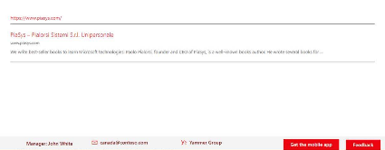
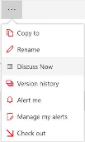
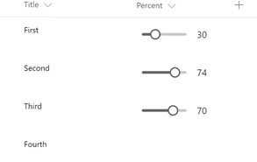
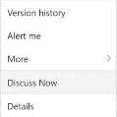
SPFx Extensions
Built with the same architecture of SPFx Web Parts
The same tool chain and deployment model as client side web parts.
Derive from a strongly typed base class wherever possible rather than manipulating the page DOM directly.
Replacing custom actions and JSLinks with “Code Parts”
Work with NoScript via tenant app catalog
Work in site collection app catalog*
Create custom field, footers and headers as well as custom command on both modern list and libraries and Pages. The same governance and ALM models available for SPFx web parts are also applied to Extensions
Application Customizer
List, Libraries, Pages
Released
Field Customizer
List, Libraries
Command Set
List, Libraries
Toolbar
ECB
Add custom rendering script to well-known placeholders
Extend the modern list command surface
Customize how columns are rendered

Slide 29
Demo: SPFx Extension

Slide 30
Tenant Properties
Tenant administrators can create and manage properties in the App Catalog that SPFx web parts & extensions can consume.
If your business logic requires a Application Key.
Store and retrieve global properties for your SPFx component in the app catalog for use in SPFx solutions.
First Release

Slide 31
Announcements – coming soon…

Slide 32
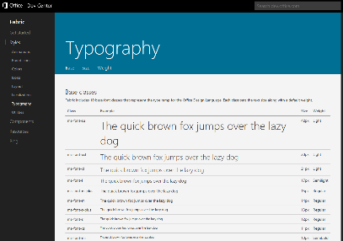
Support for Office UI Fabric core styles
Reference static Office UI Fabric styles in their SPFx components
Office UI Fabric is the set of core styles, typography, a responsive grid, animations, icons, and other fundamental building blocks of the overall design language.
Coming soon!

Slide 33
Configure Web APIs and permission scopes access
Today you get the scopes that are configured for all tenants in our service. Going forward you will be able to add scopes and Web APIs in addition to what is already provided by the service.
Governed by Tenant Administrators, who manage access to Permission Scopes and Web APIs registered in AAD directly
Access all the data available through Microsoft Graph
Interacting with 3rd Party Web APIs
Coming soon!
Examples:
Scope → Allowing user Email to be accessible via Graph Web API → Corp CRM or other line of business systems

Slide 34
ALM APIs for SPFx solutions and add-ins
Programmatically manage and deploy SPFx solutions and add-ins from tenant app catalog
Automating deployment of customizations for sites across the tenant.
Coming soon!
Examples:
Targeted deployment of a web part Provisioning of SharePoint components

Slide 35
Asset Packaging
Deploy assets (js, css, png, etc…) in your SPFx package
Deployed and hosted in SharePoint Tenant’s CDN
Allows for self contained package to be used in multiple tenants
Coming soon!

Slide 36
Site collection app catalog
Tenant Admin can allow a Site owner to have a local catalog of SPFx apps for site scoped deployment/usage
Coming soon!

Slide 37
Key Take aways
SPFx offers bold new features for On-premises and Custom code
Helper features that will make you and your development team more productive than ever before using SPFx

Slide 38
Roadmap – SPFx
Just Shipped ✔✔
SPFx On-premises (client side web parts on classic pages)
Easily deploy Web Parts and Extensions across your enterprise
Today ⏰
Yeoman Generator 1.3 that understands On-premise and Cloud
SPFx Extensions
Tenant Properties you can store and manage for your SPFx components
Coming soon ⏳
Office UI Fabric Core support
More MS-Graph support
ALM APIs for scripted deployment of SPFx components
Assets included in deployment packages
Site specific App Catalog to allow for scoped deployment

Slide 39
Learn more
Key topic breakouts below and the full listing of 70+ sessions at
http://aka.ms/spignitesessions
Code | Title | Day | Time | Pillar
BRK2250 | SharePoint Development in the Enterprise (What's New, What's Coming) | Tuesday | 4:00PM–5:15PM | Extend and develop
BRK2422 | Discover SharePoint Server 2016 Feature Pack 2 and Beyond | Wednesday | 9:00AM–10:15AM | Extend and develop
BRK3039 | Integrate OneDrive and SharePoint files, collaboration and sharing using Microsoft Graph | Wednesday | 4:00PM–5:15PM | Extend and develop
BRK3066 | Advancing the SharePoint Developer Community (PnP) | Thursday | 9:00AM–10:15AM | Extend and develop
BRK3267 | Let's build with SharePoint (Web Parts, Extensions and much more) | Thursday | 12:30PM–1:45PM | Extend and develop
BRK3252 | Geek out with the product team on SharePoint lists and libraries | Thursday | 10:45AM–12:00PM | Extend and develop
BRK4031 | Building the modern SharePoint experience: Best practices from Microsoft for developing with SPFx | Friday | 12:30PM–1:45PM | Extend and develop

Slide 40
Please evaluate this session
From your
Please expand notes window at bottom of slide and read. Then Delete this text box.
PC or tablet: visit MyIgnite https://myignite.microsoft.com/evaluations
Phone: download and use the Microsoft Ignite mobile app https://aka.ms/ignite.mobileapp
Your input is important!

